Slide 1
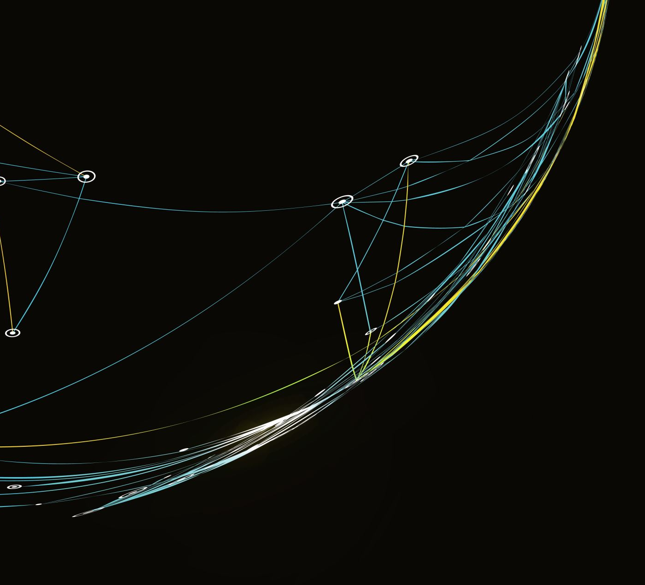
Time-Series Foundation Models (TSFM)
In Finance

Slide 2
is there a need? What is the solution?
Time series forecasting is
Hard
Confusing
expensive
A MODEL THAT IS
PRE-TRAINED
Push-button
PROVEN EFFECTIVE

Slide 3
is there a need? What is the solution?

